Slide 1
Configuration Management Plan

Slide 2
Configuration tool
Use SVN
  Tutorial at http://engtech.wordpress.com/2007/03/03/howto_google_code_hosting_subversion_tortoisesvn/
  http://code.google.com/p/htkou/wiki/SubversionTutorial
  TortoiseSVN v1.7 needed
Code is managed by Google Code
  Link: http://code.google.com/p/trade-software/source/checkout

Slide 3
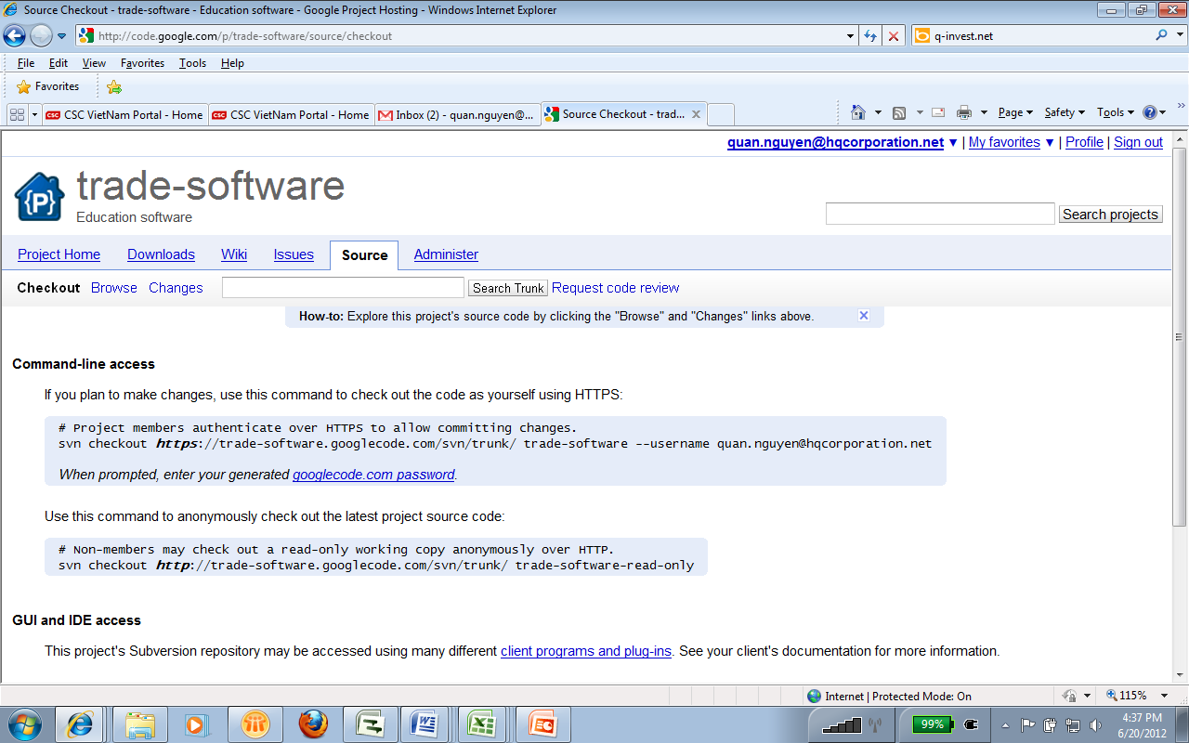
Project code
Check out the project code at https://trade-software.googlecode.com/svn/trunk/2012

Slide 4
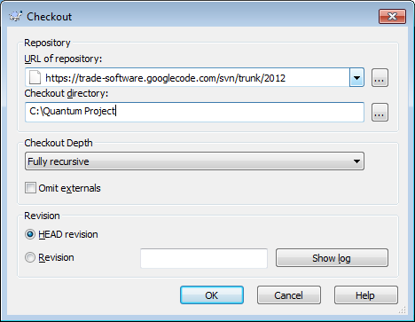
Project code (cont.)

Slide 5
For internship
Checkout at https://trade-software.googlecode.com/svn/branches/internship

Slide 6
Project document
Check out the project documentation at https://trade-software.googlecode.com/svn/Documentation

Slide 7
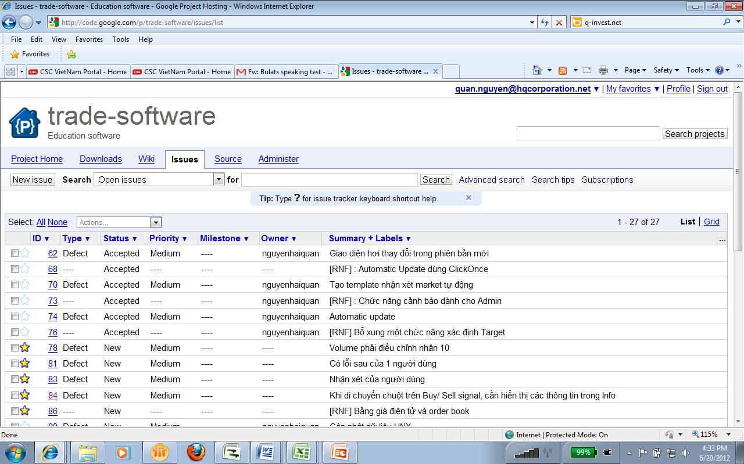
Bug management
Goto http://code.google.com/p/trade-software/issues/list

